Slide 1
Spanish 2
Clothing Descriptions
Week of 4/13
Due 4/17

Slide 2
Objetivo
Objetivo: I will use clothing nouns and adjectives in order to describe what I and others are wearing.
Topic: Clothing Descriptions

Slide 3
Los colores!
Rojo | Blanco
Azul | Negro
Amarillo | Gris
Verde | Marrón
Anaranjado | Morado
Rosado

Slide 4
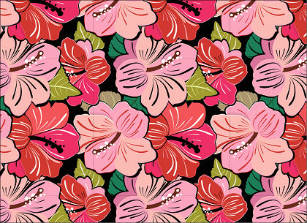
De flores - flowered

Slide 5
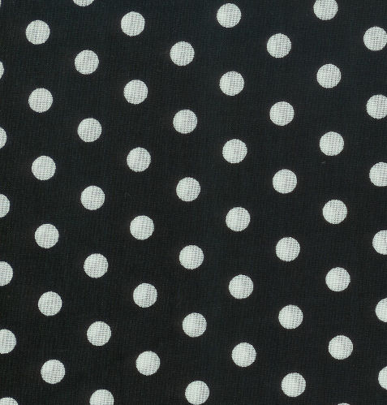
De lunares – polka dot

Slide 6
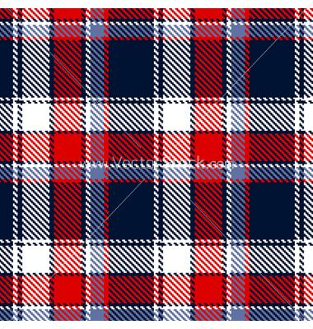
A cuadros – plaid/checkered

Slide 7
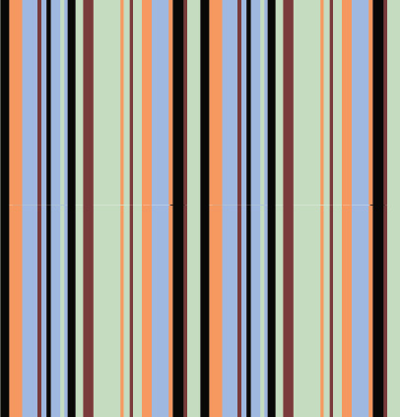
A rayas - striped

Slide 8
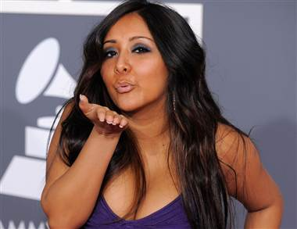
Claro - pale

Slide 9
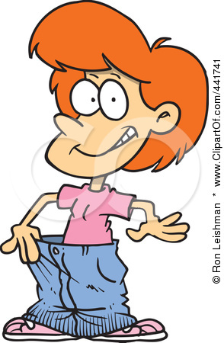
Flojo - loose

Slide 10
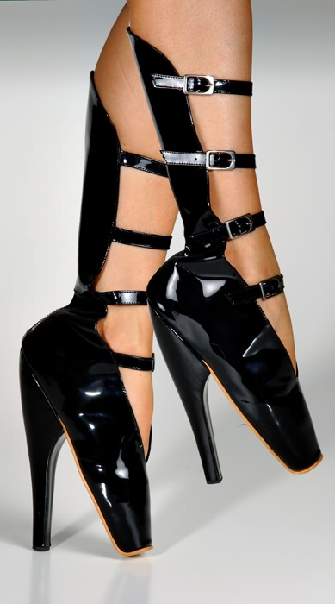
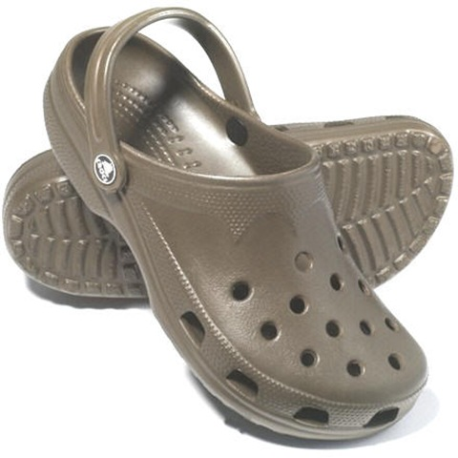
Comodo/incomodo comfortable/uncomfortable

Slide 11
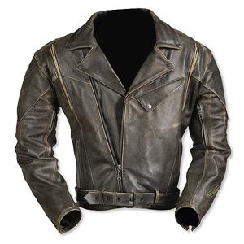
De cuero - leather

Slide 12
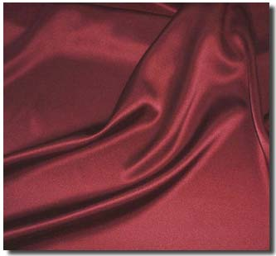
De seda - silk

Slide 13
Oscuro - dark

Slide 14
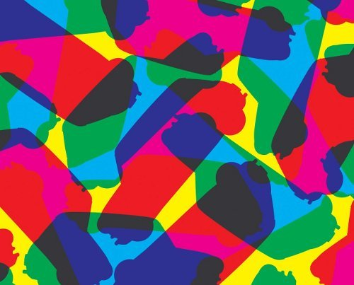
Vivo - bright

Slide 15

Pastel - pastel

Slide 16
De un solo color – solid/one color

Slide 17
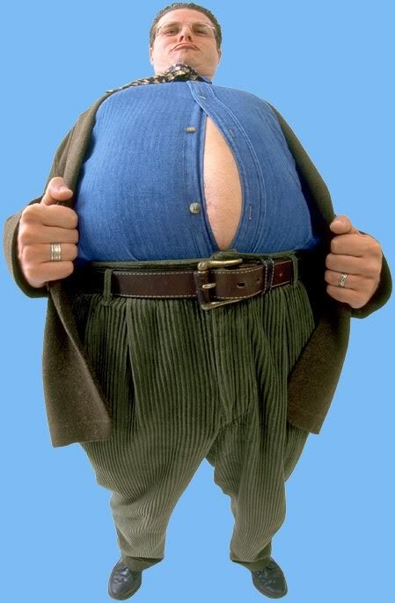
Apretado - tight

Slide 18
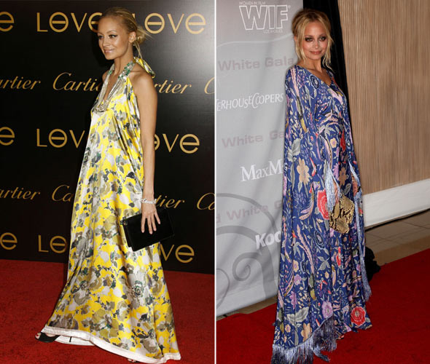
Suelto- loose

Slide 19
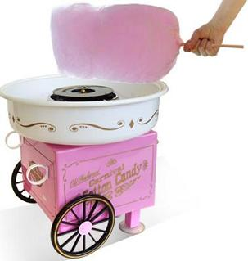
De algodón - cotton

Slide 20
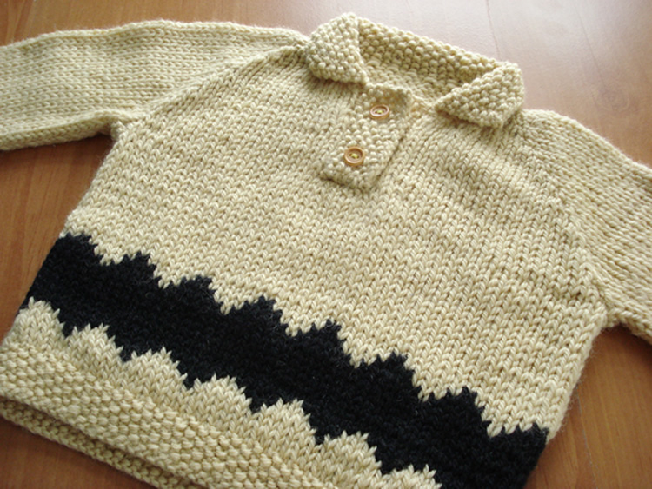
De lana - wool

Slide 21
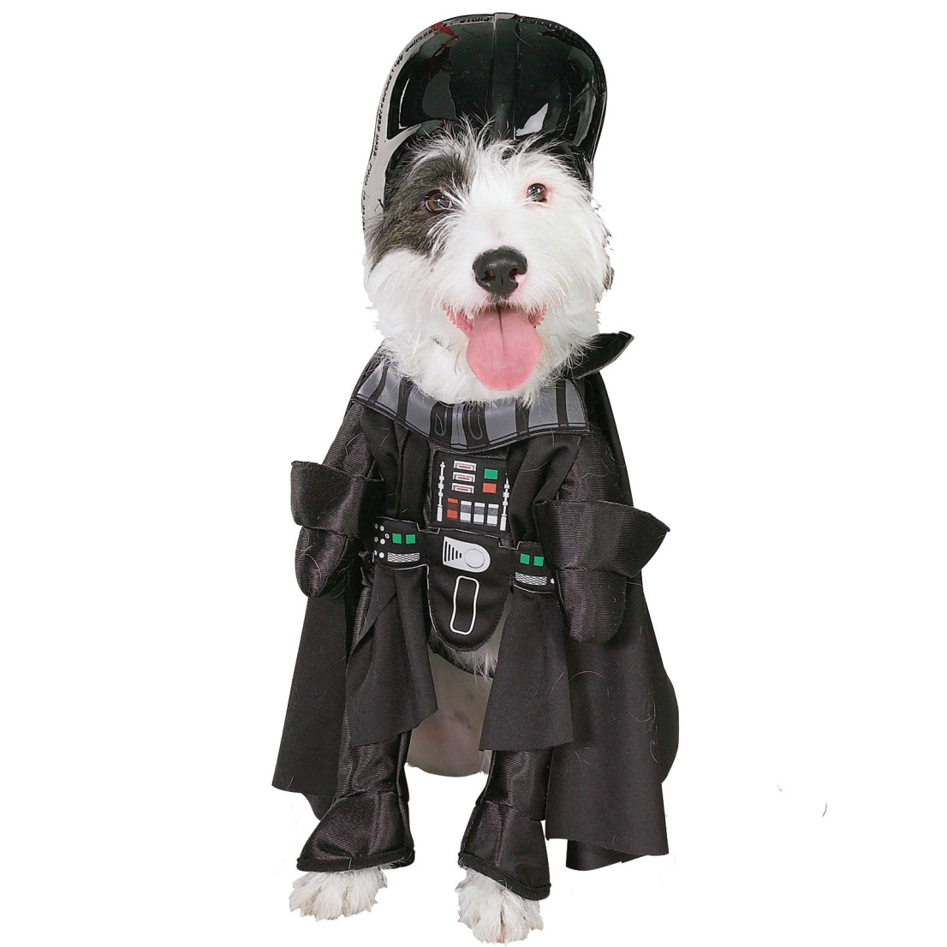
De tela sintetica – synthetic fabric

Slide 22
Remember:
AFTER
Adjectives come ______________ the noun!
Examples:
Red dress = ______________________
Cotton shirt = ____________________
Vestido rojo
Camisa de algodón

Slide 23
ALSO!!!
AGREE
Everything must always ___________!
Examples:
Yellow pants = ______________________
Comfortable t-shirt = ____________________
Pantalones amarillos
Camiseta cómoda

Slide 24
With more than one description, color comes first.

Slide 25
Write a sentence describing what the person is wearing based on what you see in the picture

Slide 26
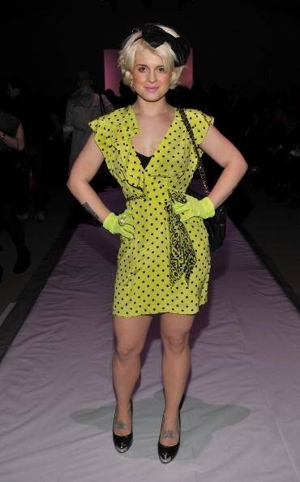

Slide 27
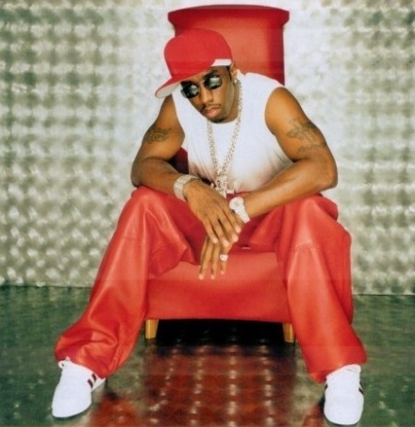

Slide 28
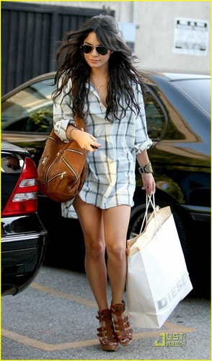

Slide 29
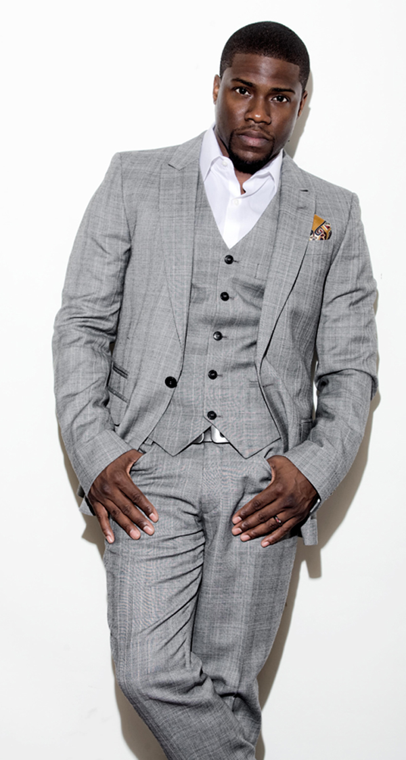

Slide 30
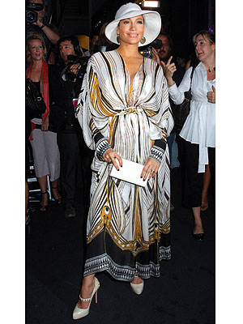

Slide 31
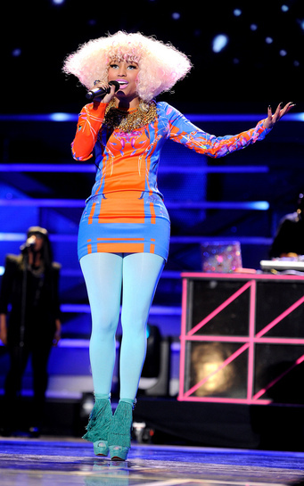

Slide 32
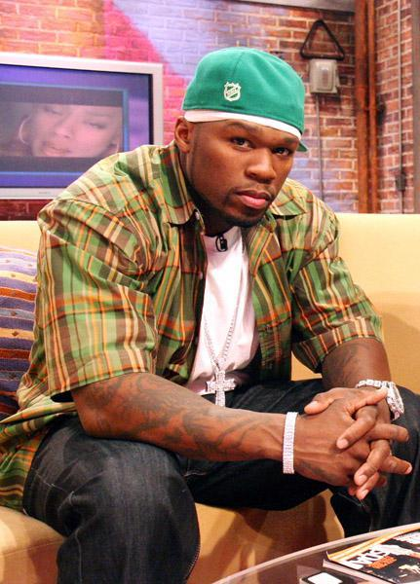

Slide 33
